Slide 1

b u t t e r f l i
Application concept by Benjamin Bryant.
Privacy model by Benjamin Bryant.
Butterfly clipart from openclipart.org
Freedom to be Truly Social

Slide 2
Future bottom bar Functions
Map
Search
Chat
History
b u t t e r f l i
b u t t e r f l i
Main Menu
Listen
Coach
Freedom to be
Truly Social
Call
Freedom to be Truly Social
Events
Utilities
Activity
Share
My World
Modules
Settings

Slide 3
b u t t e r f l i
b u t t e r f l i
Activity Use Case
Freedom to be Truly Social
Activity
Share
My World
Modules
Settings

Slide 4
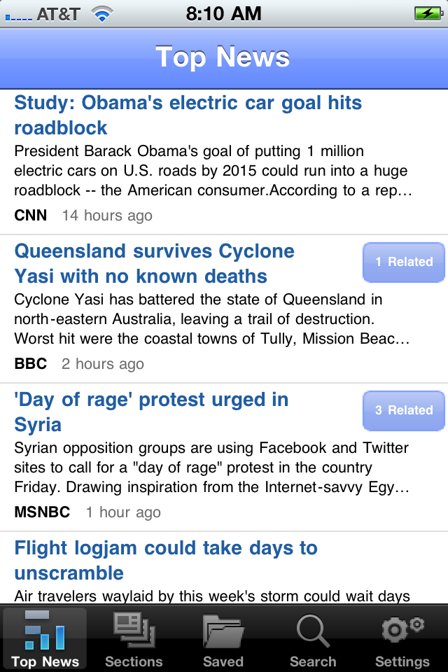
Butterfly
butterfli displays recent social network activity – email, facebook, twitter, etc – for all contacts within the selected context according to their contact details AND the networking modules configured.
Display is very similar to a news aggregator (Fluent display is used as an example), except wth add’l functionality for email replys, facebook comments, forwards, etc.
To change context, simply tap the mini model in the upper right.
Activity
Share
Browse
Associate
Configure
Activity
Share
My World
Modules
Settings

Slide 5
Butterfly
The World
All Connections
User selects the area of the his network where he would like to look at recent social content.
Tap to select.
Hold to drill in.
Share
Browse
Personal
Professional
Associate
Configure
Family
Activity
Share
My World
Modules
Settings

Slide 6
b u t t e r f l i
b u t t e r f l i
Sharing Use Case
Tap to enter
Freedom to be Truly Social
Activity
Share
My World
Modules
Settings

Slide 7
Share
<Menu
What?
Tap to edit; will show preview once finished.
Who with?
How?
Go!
Activity
Share
My World
Modules
Settings

Slide 8
Share
<Menu
What?
Tap to edit; will show preview once finished.
Who with?
How?
Go!
Activity
Share
My World
Modules
Settings

Slide 9
Share, what?
<Share
What would you like to share?
Status message
Default options, more can be added with modules.
Picture
Internet Link
Video
Done
Activity
Share
My World
Modules
Settings

Slide 10
Share, what?
<Share
What would you like to share?
Status message
Tap to select/edit.
Picture
Internet Link
Video
Done
Activity
Share
My World
Modules
Settings

Slide 11
Share, what?
<Share
Status message:
I’m designing a killer app
for the iPhone!
Once an option is selected then it expands and the other options are faded out.
Tap “done” to finish.
Done
Activity
Share
My World
Modules
Settings

Slide 12
Share
<Menu
Status Message:
I’m designing a killer app…
Will show preview once option is finished.
Tap “who with” to select recipients.
Who with?
How?
Go!
Activity
Share
My World
Modules
Settings

Slide 13
Share, who with?
<Share
Who would you like to share with?
The World
All Connections
This is the customizable privacy model. Contacts are all organized within the model under “My World” in the main menu in order to facilitate real relationship classifications.
Tap to select.
Hold to drill in.
Personal
Professional
Family
Activity
Share
My World
Modules
Settings

Slide 14
Share, who with?
<Share
Who would you like to share with?
The World
All Connections
Personal
Professional
Hold to drill in.
Family
Activity
Share
My World
Modules
Settings

Slide 15
Share, who with?
<Share
Who would you like to share with?
Professional
The World
All Connections
Tap to toggle selection.
Double tap to zoom back out, or tap Done to continue.
Coworkers
Customer
Contacts
Personal
Project Team
Business
Partners
Family
Others?
Done
Activity
Share
My World
Modules
Settings

Slide 16
Share
<Menu
Status Message:
I’m designing a killer app…
With Professional,Business
Partners.
How?
Tap to edit;
Go!
Activity
Share
My World
Modules
Settings

Slide 17
Share, how?
<Share
Options are available according to facilities set up in “Config” section.
Facebook wall posts will have privacy restricted to specific contacts.
If a more broad context was selected, then options for restricted Twitter, LinkedIn, etc could be shown.
If the “world” was selected, then we could post to a blog, usenet group, or something else that is public.
Email
Text Message
Facebook, My Wall
Facebook, Inbox message
Done
Activity
Share
My World
Modules
Settings

Slide 18
Share, how?
<Share
Email
Text Message
Tap to toggle options on or off.
Facebook, My Wall
Facebook, Inbox message
Done
Activity
Share
My World
Modules
Settings

Slide 19
Share
<Menu
Status Message:
I’m designing a killer app…
With Professional,Business
Partners.
Tap to edit; will show preview once finished.
Tap Go to execute.
Via Facebook Wall and
Text Message.
Go!
Activity
Share
My World
Modules
Settings

Slide 20
Sharing!
<Share
Sending SMS message “…” to <name>, <name>, <name>…
Done!
Posting status message to Facebook wall with privacy limited to <name>, <name>, <name>…
Done!
Default options, more can be added with modules.
Done
Activity
Share
My World
Modules
Settings

Slide 21
b u t t e r f l i
b u t t e r f l i
My World Use Case
Tap to enter
Freedom to be Truly Social
Activity
Share
My World
Modules
Settings

Slide 22
My World
Click Here to add a contact or Select an area below
The World
All Connections
This is the customizable privacy model.
Contacts and Modules are all classified within this model..
Tap to select.
Hold to drill in.
Personal
Professional
Family
Activity
Share
My World
Modules
Settings

Slide 23
My World
Click Here to add a contact or Select an area below
Tap to select.
The World
All Connections
Personal
Professional
Family
Activity
Share
My World
Modules
Settings

Slide 24
New Contact
butterfli keeps a metabase of contact information – probably with locally cached data.
butterfli does not own the substance of the contact data – which would be owned by the linked resources.
Linked resources are available according to which Modules are configured, i.e. the LinkedIn option will only be available if the LinkedIn module is installed and configured.
iPhone Contact
Facebook Contact
LinkedIn Contact
Google Profile
Etc…
Continue
Activity
Share
My World
Modules
Settings

Slide 25
New Contact
iPhone Contact
Hold to edit
Facebook Contact
LinkedIn Contact
Google Profile
Etc…
Continue
Activity
Share
My World
Modules
Settings

Slide 26
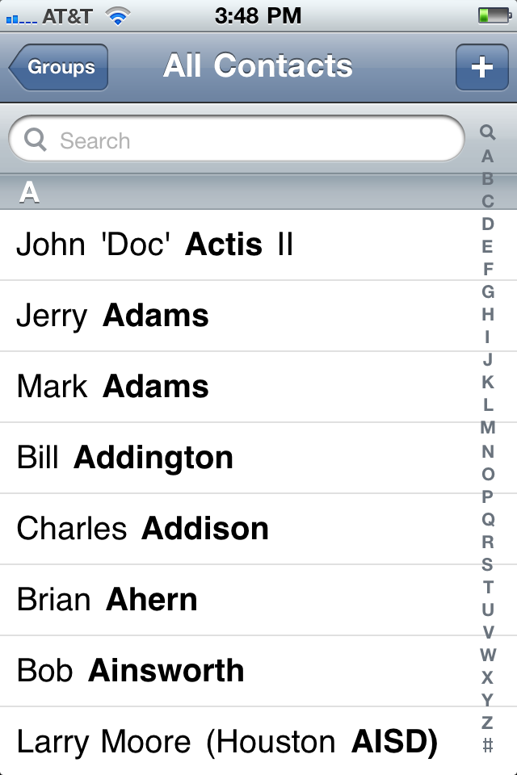
Tap to Select
Activity
Share
My World
Modules
Settings

Slide 27
New Contact
Configured options will show a preview of information stored, picture, numbers, address, etc
iPhone contact is required and will serve as pr
Tap to view or edit details
Or tap another option to set up
Primary email will be selectable option from email addresses pulled
Tap continue
iPhone Contact:
Bill Addington
Facebook Friend
LinkedIn Connection
Primary email…
Etc…
Continue
Activity
Share
My World
Modules
Settings

Slide 28
New Contact
Tap to toggle selection.
Hold to drill in.
Multiple selections can be made.
BUT…
Direct association with a less-trusted (outer) circle should negate association with a more trusted circle if selected.
Direct association with an inner circle implies indirect association with all surrounding circles.
What kind of contact is <name>?
The World
All Connections
Personal
Professional
Family
Done
Activity
Share
My World
Modules
Settings

Slide 29
My World
Click Here to add a contact or Select an area below
The World
All Connections
Back to main My World page.
Personal
Professional
Family
Activity
Share
My World
Modules
Settings

Slide 30
My World
Click Here to add a contact or Select an area below
The World
All Connections
Personal
Tap to select and area to manage.
Professional
Family
Activity
Share
My World
Modules
Settings

Slide 31
My World
Professional
The World
All Connections
Coworkers
Customer
Contacts
Personal
Project Team
Business
Partners
Tap to select.
Family
Others?
Activity
Share
My World
Modules
Settings

Slide 32
My World
Professional:
I am still unsure how we should link contacts from different modules/sources.
Click to open contact and view/modify data where applicable.
I would like to have an interactive discussion about contact layout, linking and presentation within the model.
iPhone Contact:
Bill Addington
Activity
Share
My World
Modules
Settings

Slide 33
b u t t e r f l i
b u t t e r f l i
Modules Use Case
Tap to enter
as social as you want
Activity
Share
My World
Modules
Settings

Slide 34
Modules
List of installed modules
Modules are of three types (possibly more):
1. communication – used to interact with different information sources, social networks, and communication media
2. content sharing – status, photos, location, videos, files, etc.
3. features – (see slide 2) basically whatever will populate the bottom nav bar
iPhone – contact list, SMS
Email: (address)
Facebook: (username)
LinkedIn: (username)
Add new module...
Activity
Share
My World
Modules
Settings

Slide 35
b u t t e r f l i
b u t t e r f l i
Settings Overview
Tap to enter
as social as you want
Activity
Share
My World
Modules
Settings

Slide 36
General application settings:
Colors, text size, alerts
Metadata backup/restore to pw-encryped zip in Drafts email folder
Future: PKI for email
Activity
Share
My World
Modules
Settings

